Slide 1
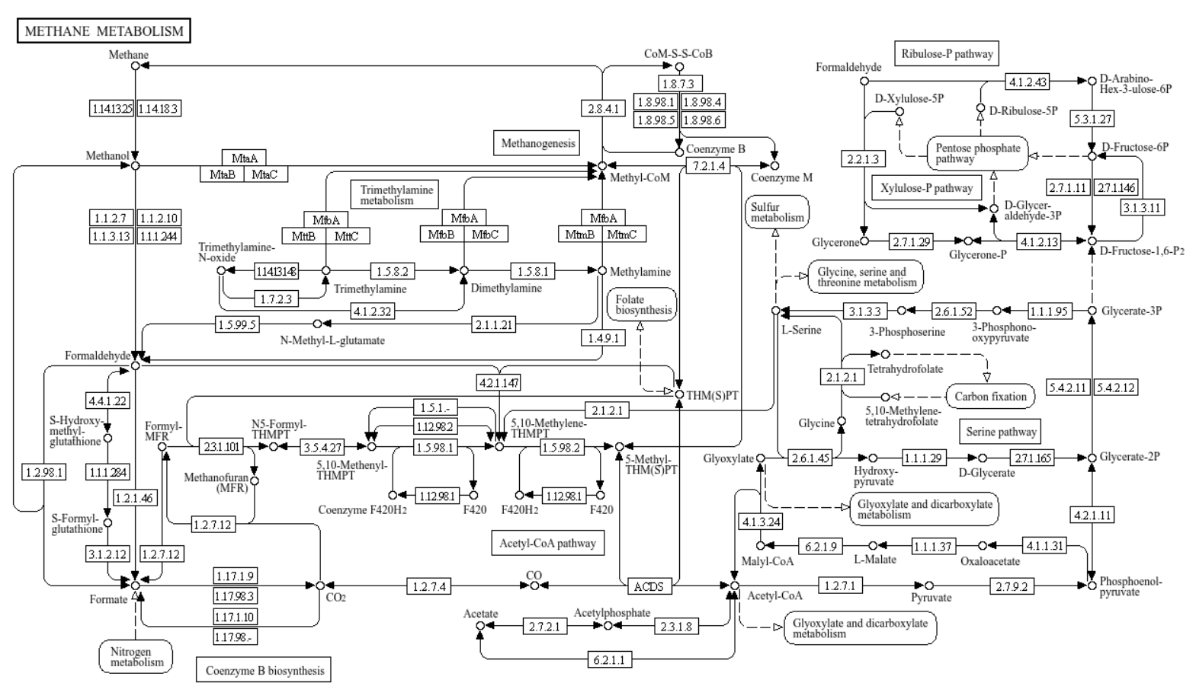
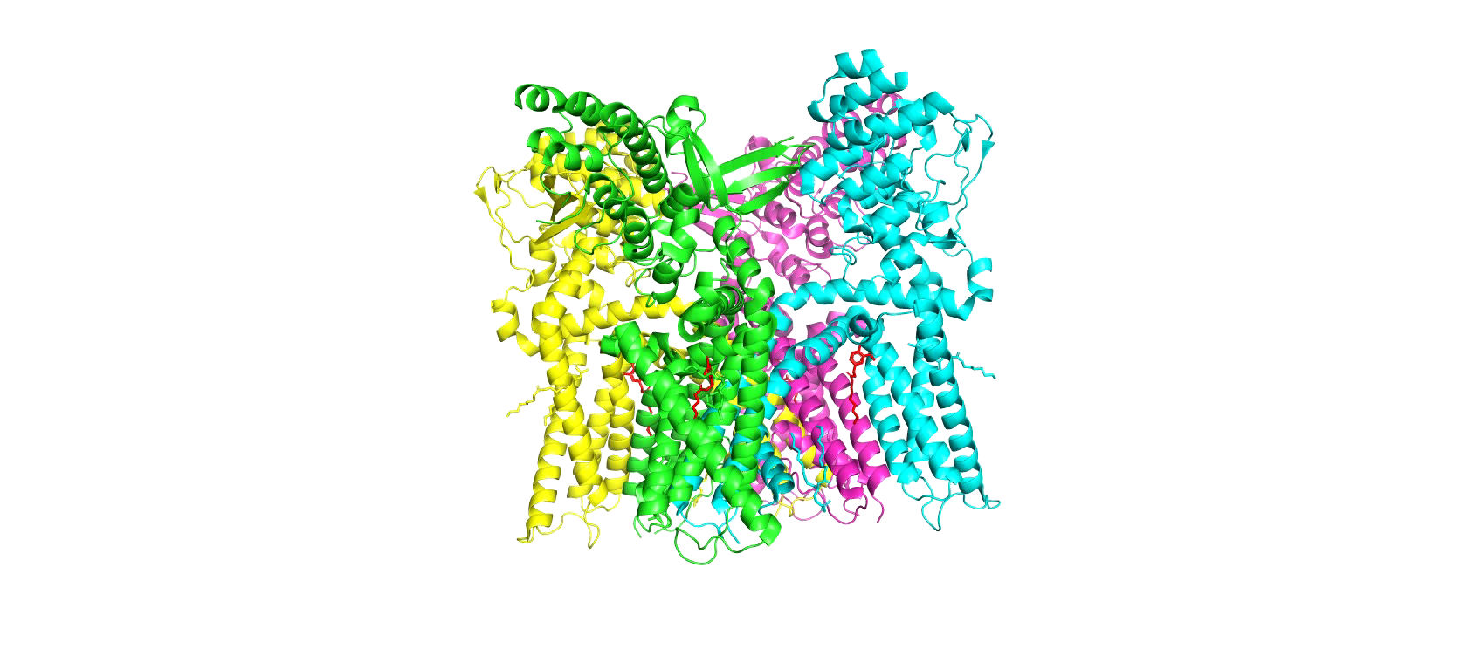
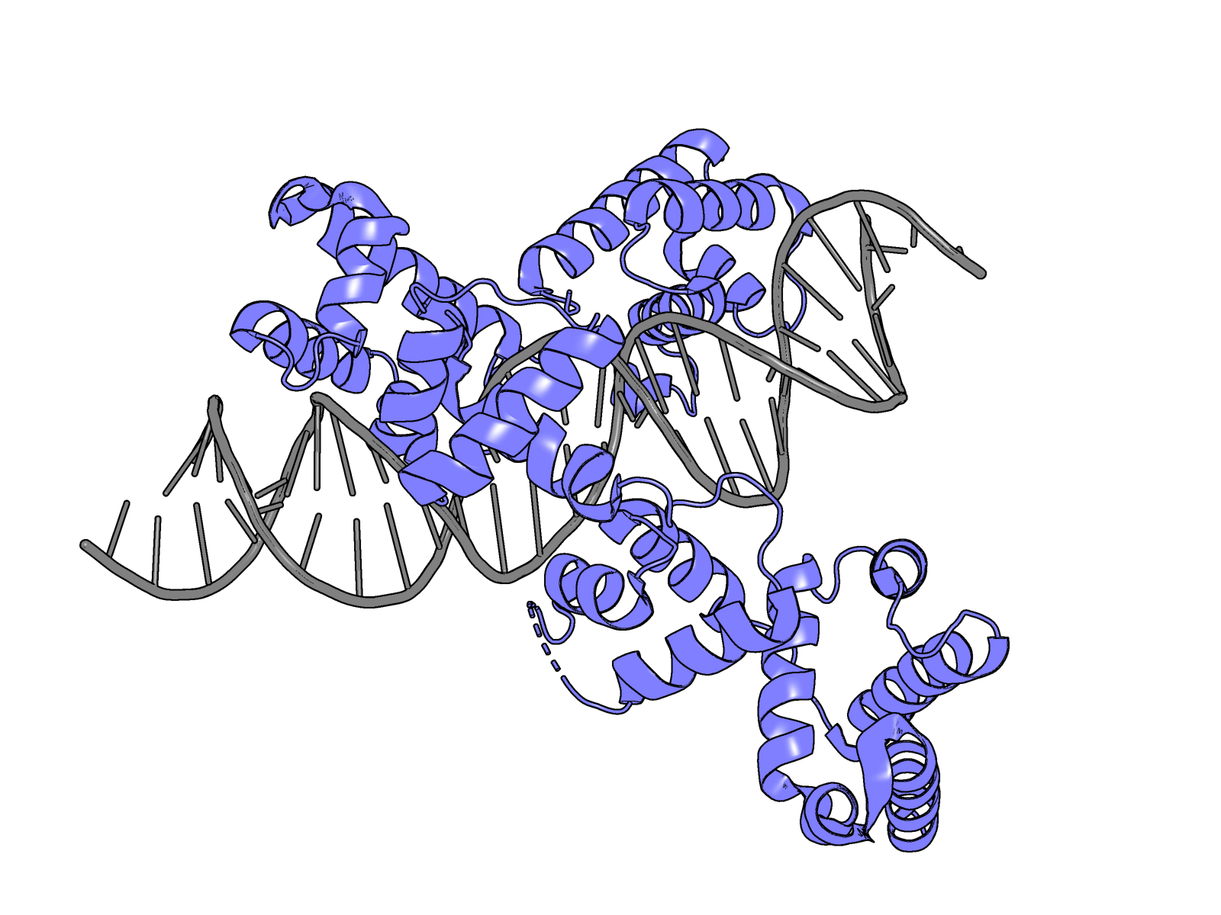
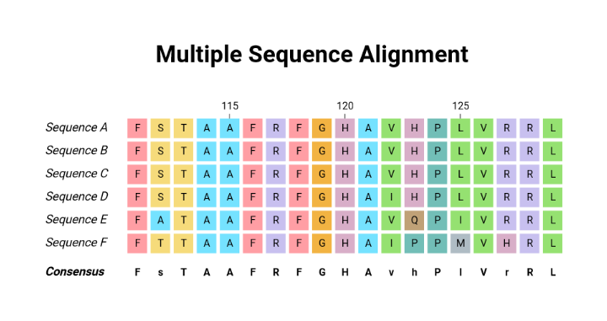
Protein Bioinformatics
CM515 Spring 2025

Slide 2
Protein Bioinformatics
CM515 Spring 2025
Introduction to some useful tools for proteins
BLASTP
RCSB/PDB
KEGG
UniProt
Pymol
Alphafold3

Slide 3
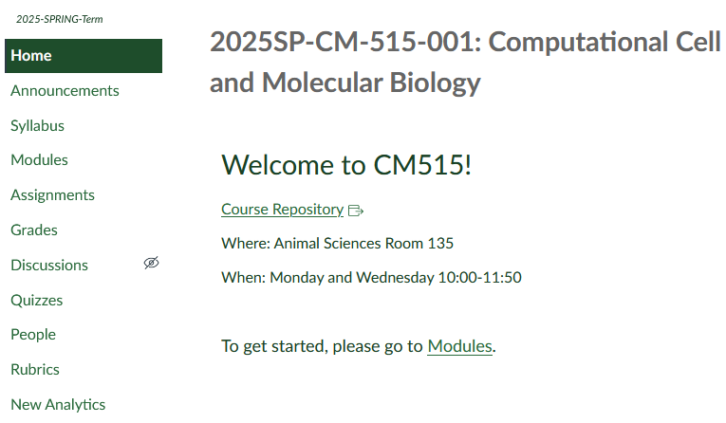

Find your Protein Sequence

Slide 4

BLASTP
Basic Local Alignment Search Tool Protein
Identify Related Proteins by Sequence Alignment
Compare and Contrast Similarities and Differences Across Species
BLAST can be run as a standalone program, but NCBI provides a web portal that searches the entire database of known genomes
How to Access:
https://blast.ncbi.nlm.nih.gov/

Slide 5
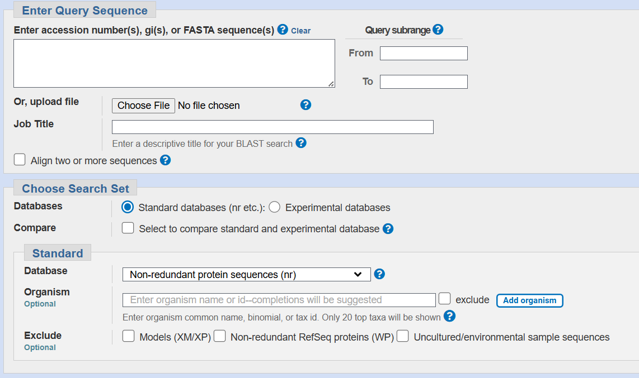
BLASTP
Basic Local Alignment Search Tool Protein
Input Target Sequence

Slide 6
BLASTP
Basic Local Alignment Search Tool Protein
Leave Unchecked if you want to check against databases
Check if you want to specifically align certain sequences

Slide 7

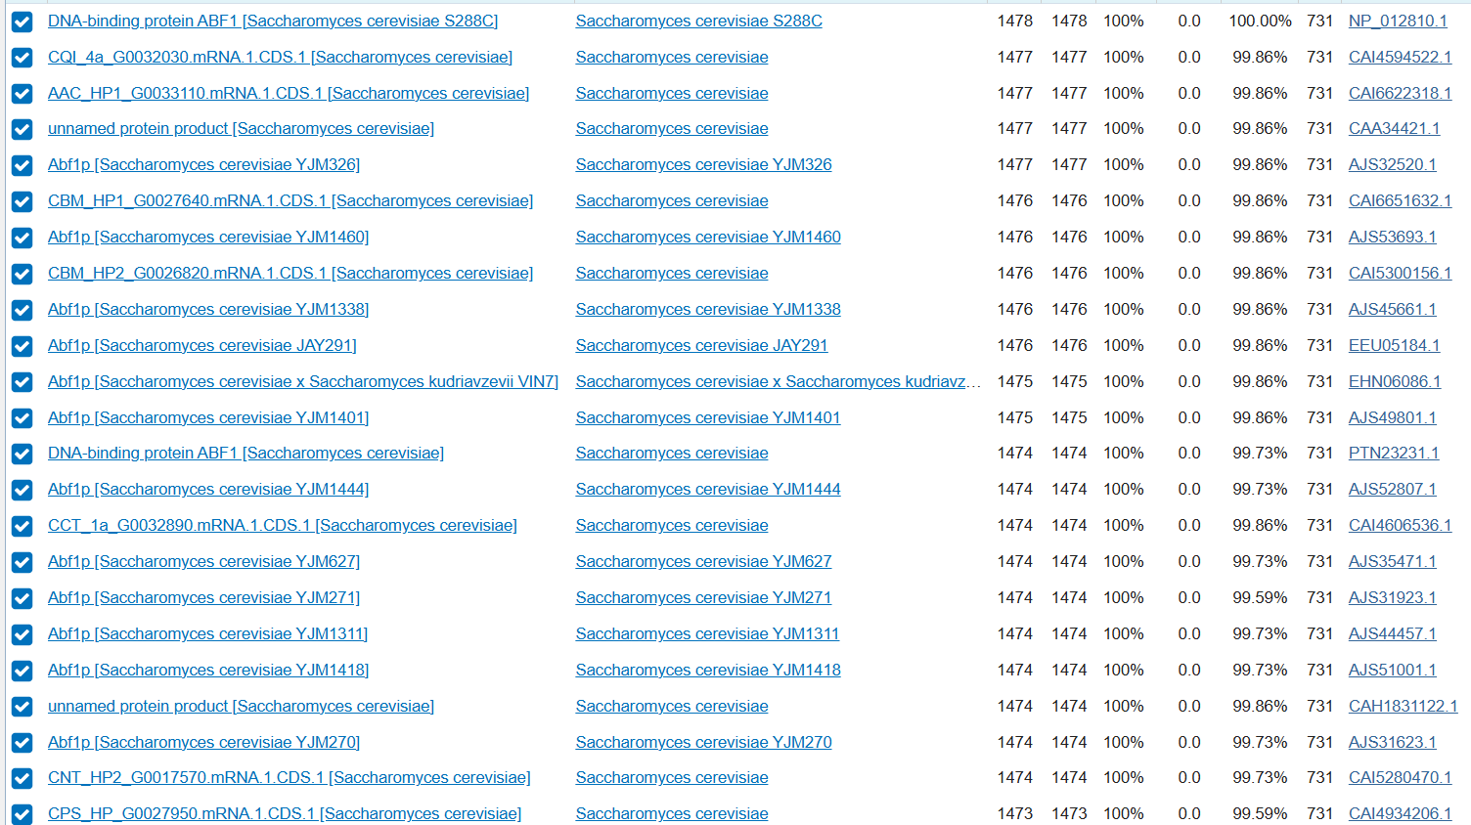
BLASTP
Basic Local Alignment Search Tool Protein
Results
Description
Useful for quick overview of similar proteins

Slide 8
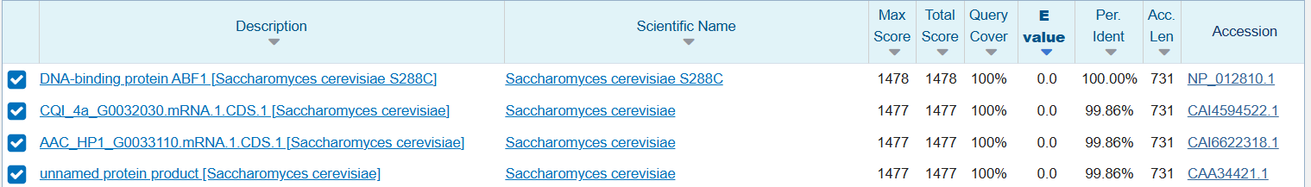
BLASTP
Basic Local Alignment Search Tool Protein
How many amino acids are identical
Protein “Name”
Species Name
How well did it align

Slide 9
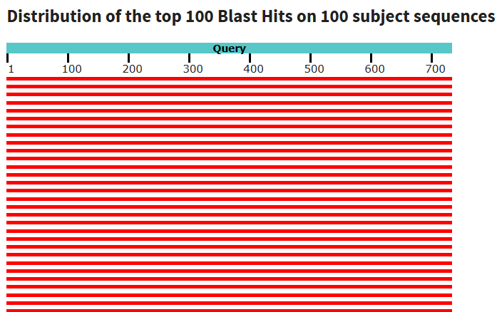
BLASTP
Basic Local Alignment Search Tool Protein
Graphic Summary
Visually compare alignments
Color indicates alignment score

Slide 10
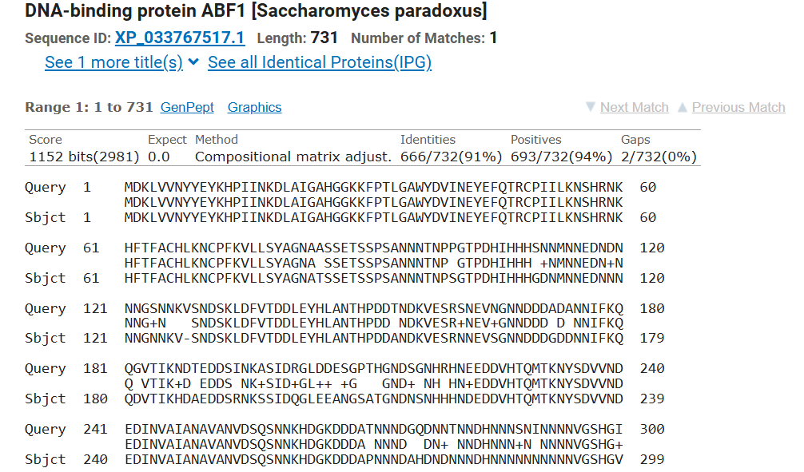
BLASTP
Basic Local Alignment Search Tool Protein
Alignments:
Compare individual alignments
Identities: Exact amino acid matches
Positives: Functional amino acid matches (e.g., Isoleucine and Leucine)

Slide 11
BLASTP
Basic Local Alignment Search Tool Protein
Question 1 on the Assignment

Slide 12
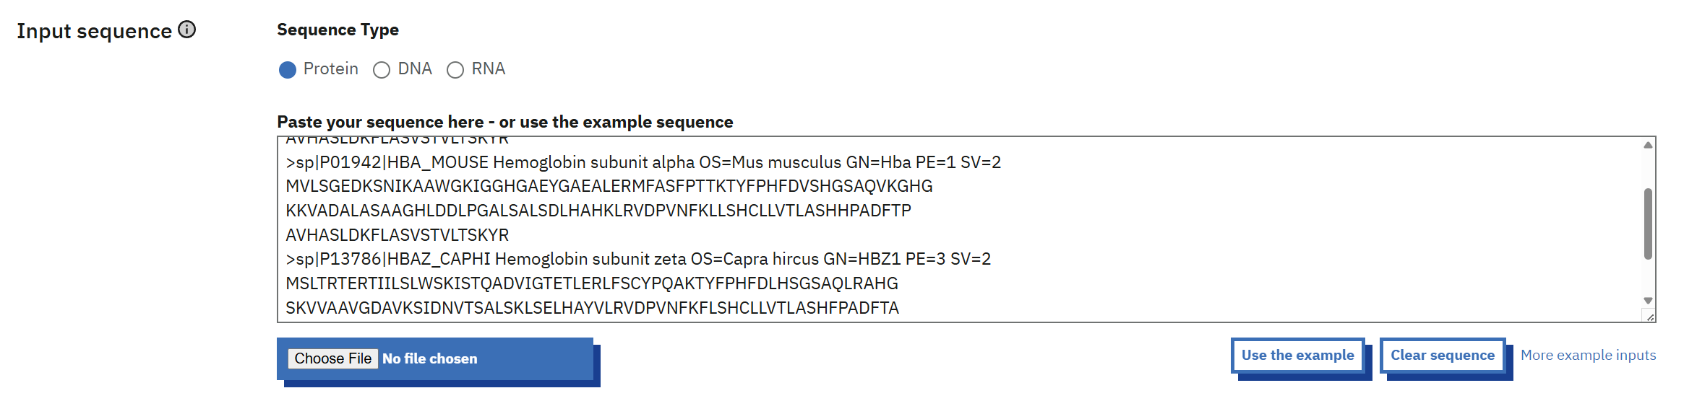
Clustal Omega
Multiple Sequence Alignment
How to Access:
https://www.ebi.ac.uk/jdispatcher/msa/clustalo
Useful for comparing conserved protein regions across species
Input Targets in FASTA format

Slide 13
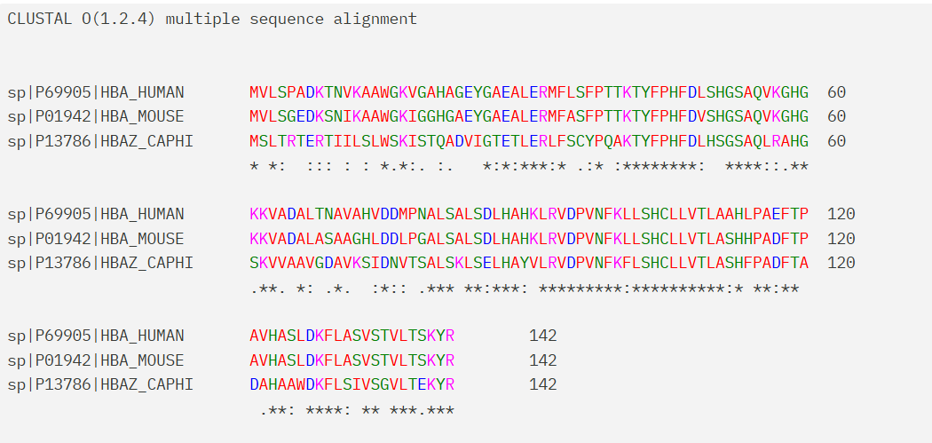
Clustal Omega
Multiple Sequence Alignment
: = Similar Amino Acid
* = exactly conserved

Slide 14
Clustal Omega
Multiple Sequence Alignment
Question 2 on the Assignment

Slide 15
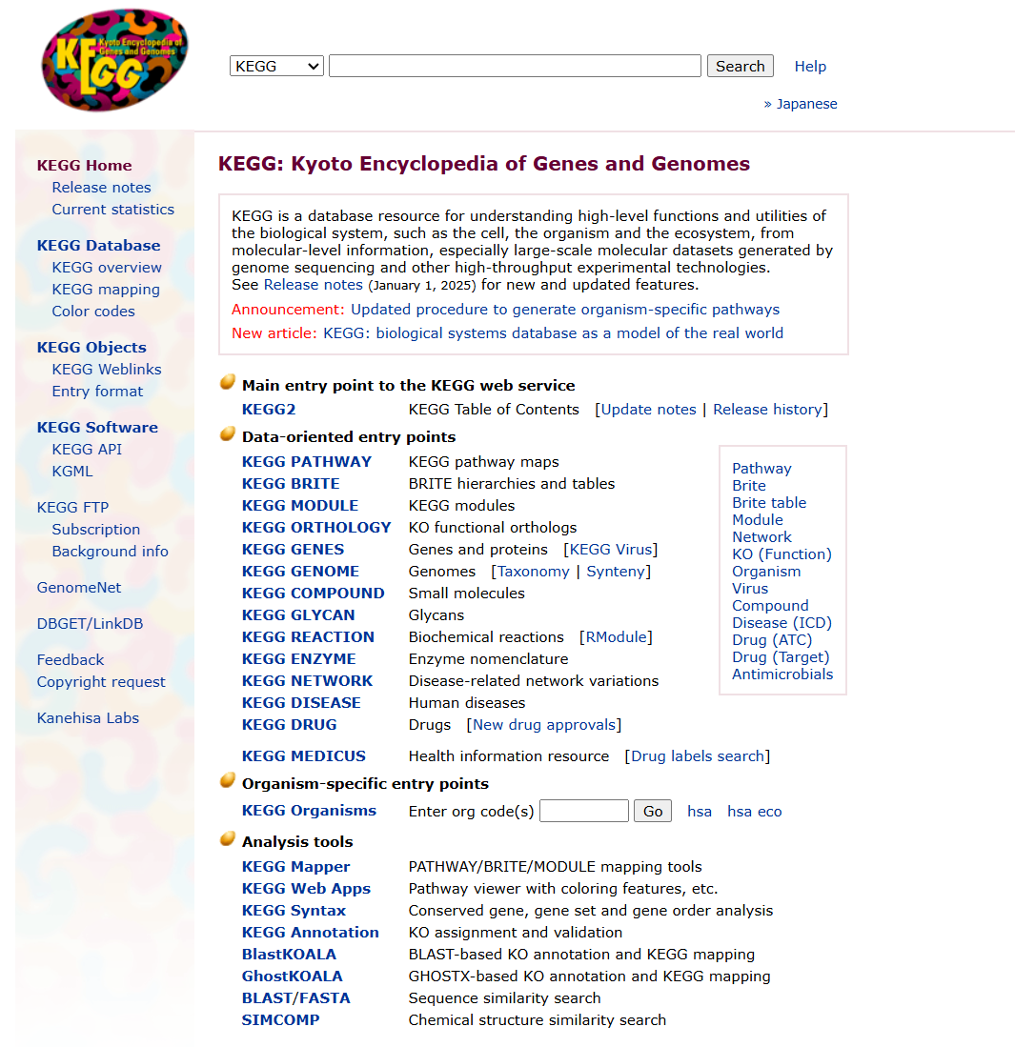
KEGG
Kyoto Encyclopedia of Genes and Genomes
How to Access:
https://www.genome.jp/kegg/
Find Organism Code
Organism Codes are how you can search for genes specific to a species on KEGG

Slide 16
KEGG
Kyoto Encyclopedia of Genes and Genomes
How to Access:
https://www.genome.jp/kegg/
Use Organism Code and Protein Name to Search
With the organism code and protein name you should be able to find your gene/protein of interest directly via the searchbox

Slide 17
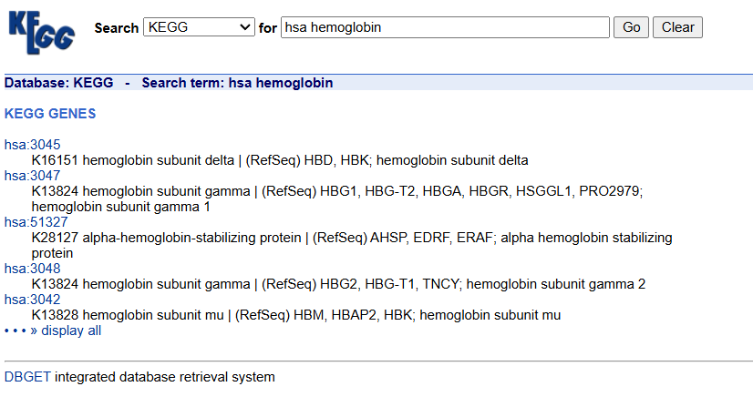
KEGG
Kyoto Encyclopedia of Genes and Genomes
Organism Code: Gene Number

Slide 18
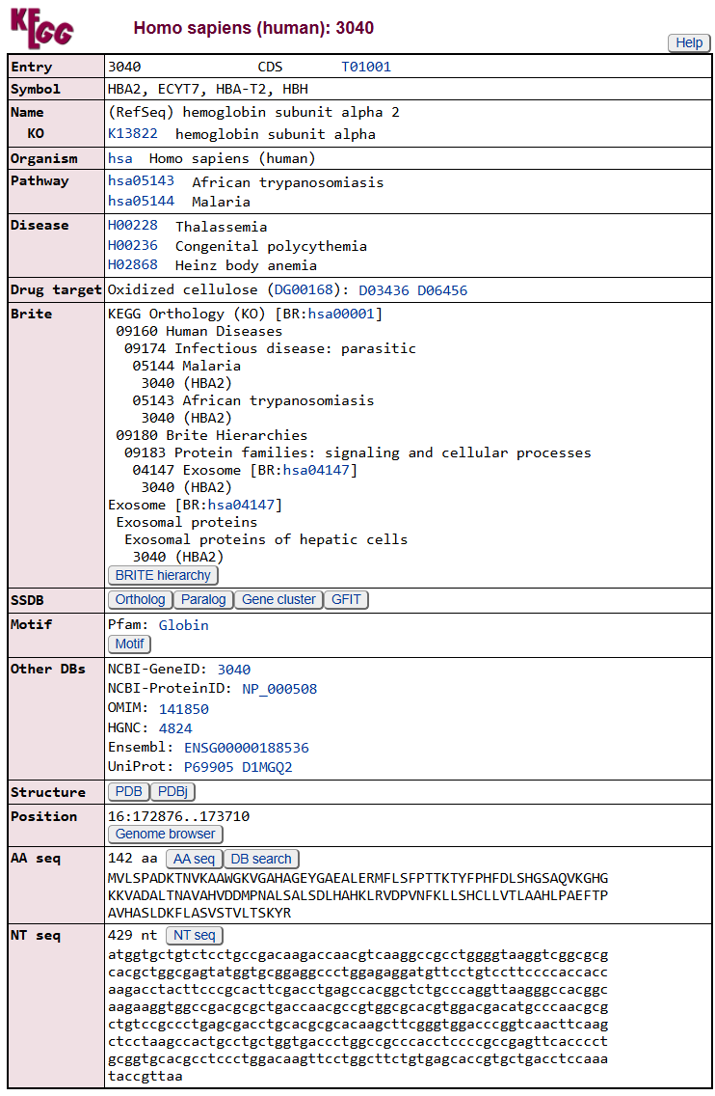
KEGG
Kyoto Encyclopedia of Genes and Genomes
Any KEGG Pathways the gene is a part of

Slide 19
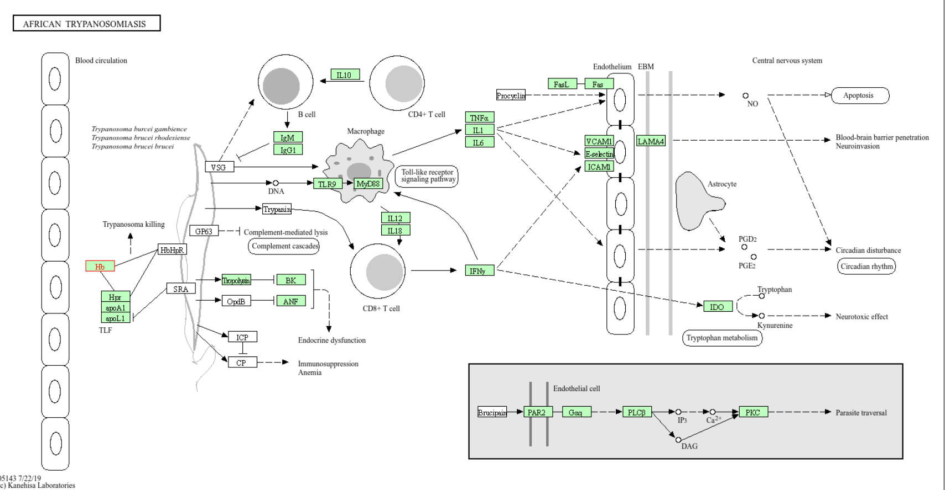
KEGG
Kyoto Encyclopedia of Genes and Genomes
Highlighted Box is where you came from
Links to related pathways
Green boxes will take you to KEGG page for the gene

Slide 20
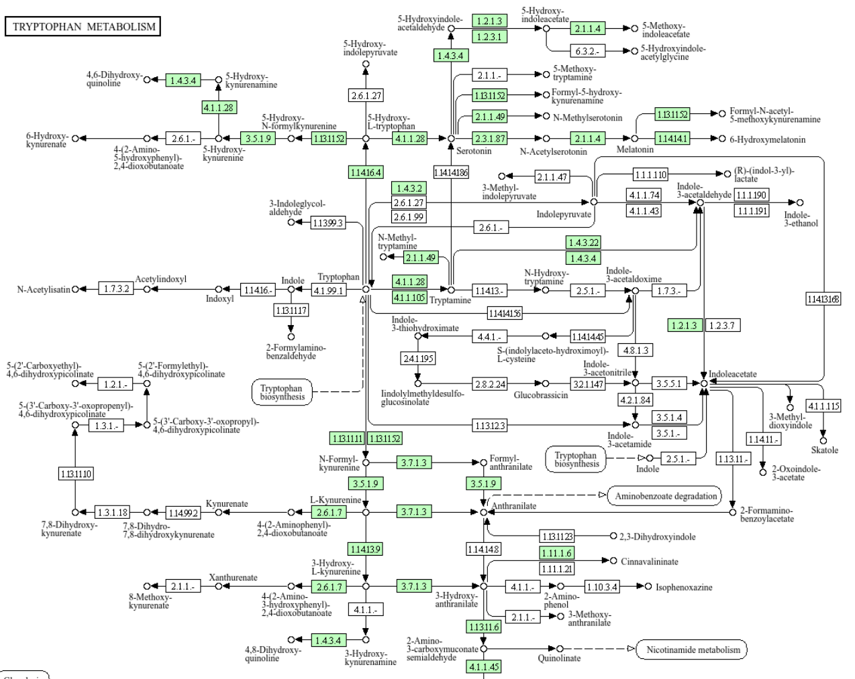
KEGG
Kyoto Encyclopedia of Genes and Genomes
If the pathway is enzymatic, dots can link to small molecules

Slide 21
KEGG
Kyoto Encyclopedia of Genes and Genomes
Question 3 on the Assignment

Slide 22
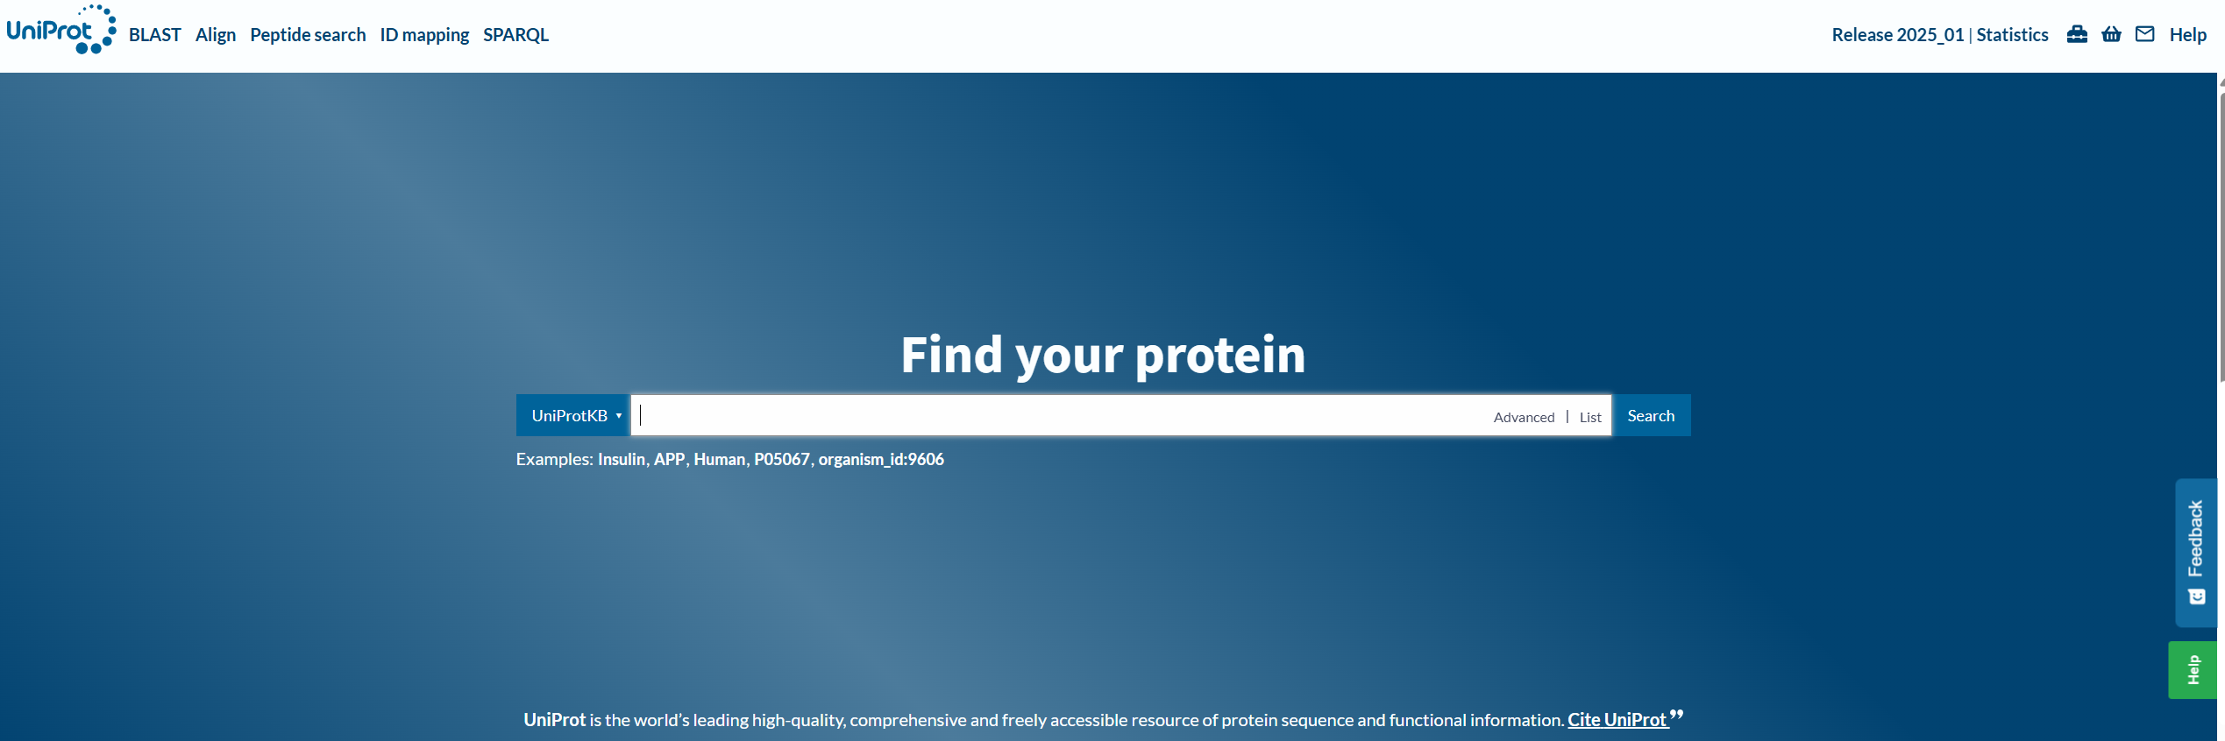
UniProt
How to Access:
https://www.uniprot.org/
Search for protein of interest
The KEGG code you identified earlier should work as well

Slide 23
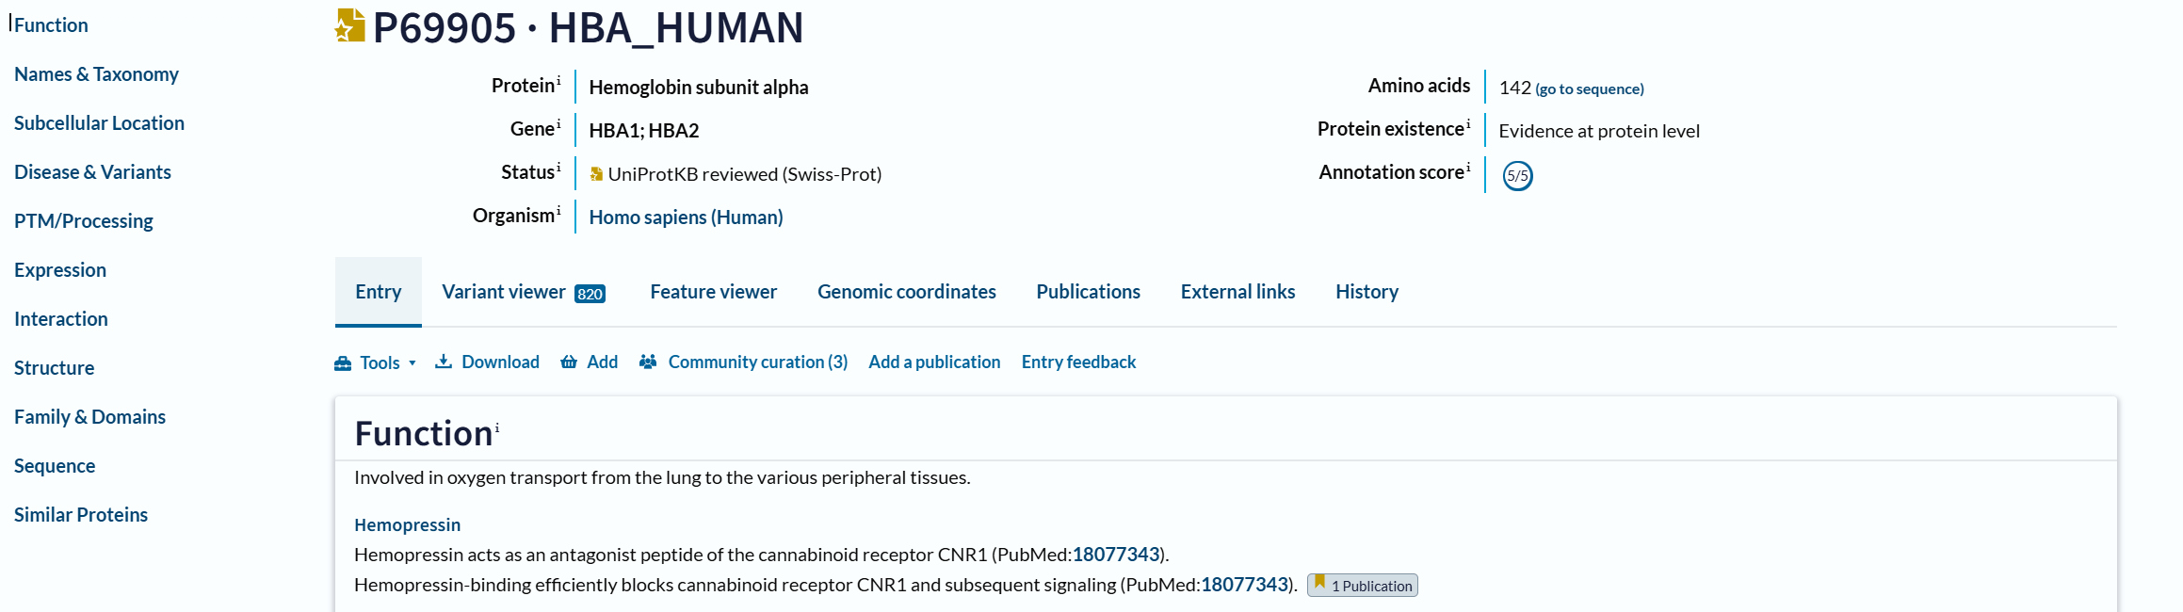
UniProt
Straightforward to navigate to section of interest

Slide 24
UniProt
Question 4 on the Assignment

Slide 25
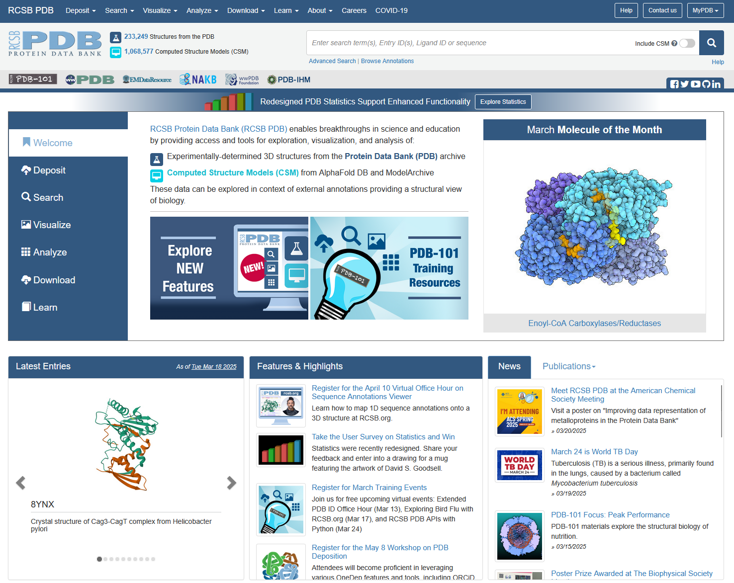
RCSB/PDB
Protein Data Bank
Search for protein of interest
Protein name might be enough, but searching by protein sequence gives better results
How to Access:
https://www.rcsb.org/

Slide 26
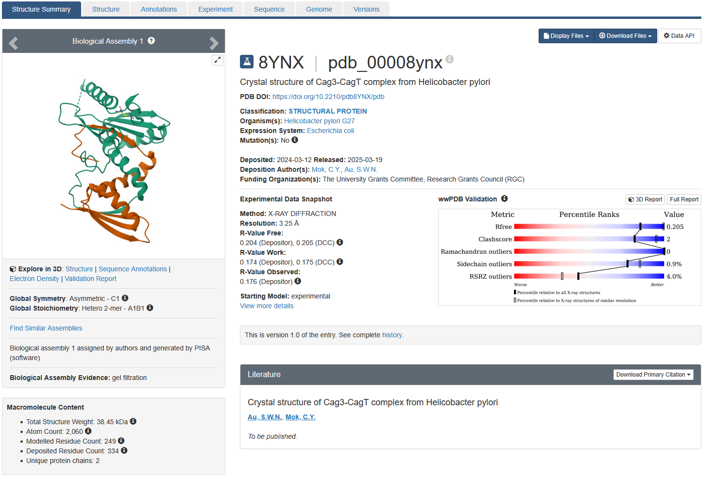
RCSB/PDB
Structure Visualization
Protein Data Bank
Method
Paper

Slide 27
RCSB/PDB
Protein Data Bank
Question 5 on the Assignment

Slide 28
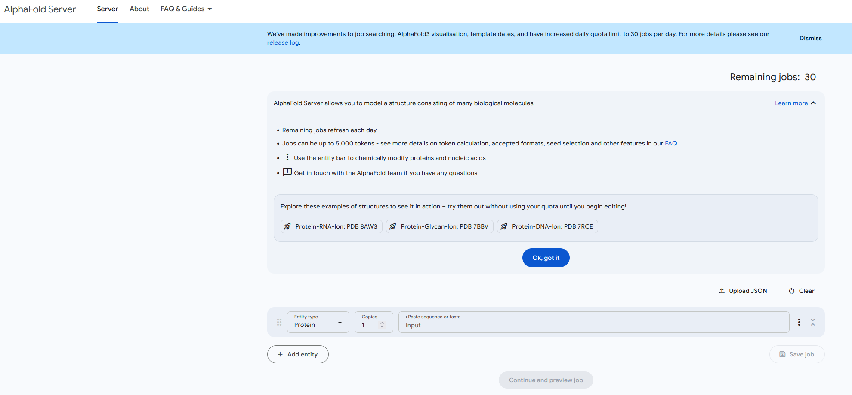
AlphaFold3
How to Access:
https://alphafoldserver.com/
Input Sequence

Slide 29
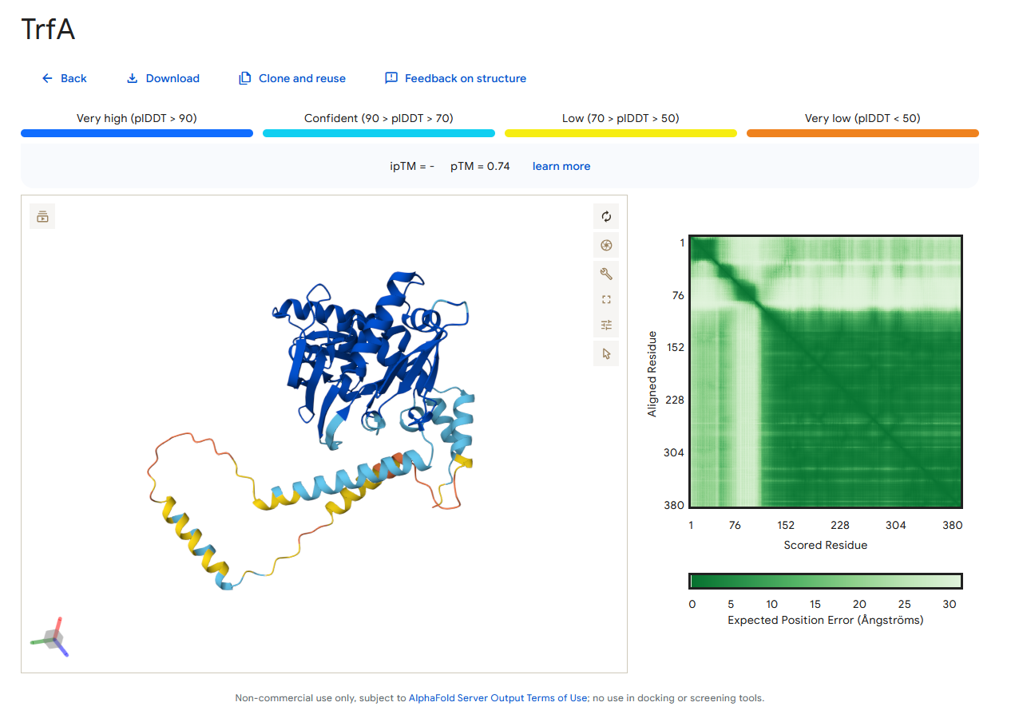
AlphaFold3
plDDT: Confidence in individual residue positioning
>80 plDDT means it’s probably right
Confidence in the position of subunits in complex
Confidence in total complex

Slide 30
AlphaFold3
.pdb files can be downloaded here

Slide 31
AlphaFold3
Question 6 on the Assignment

Slide 32
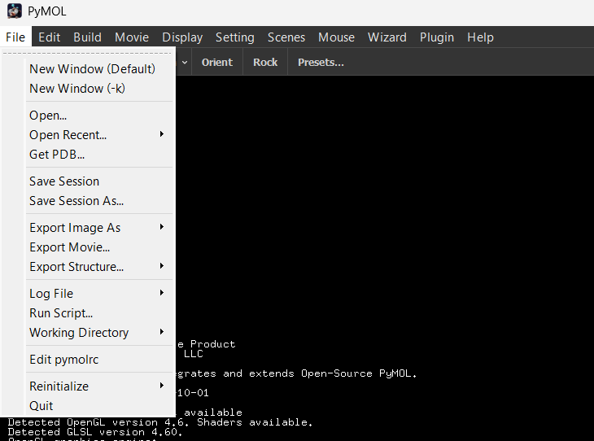
PyMOL
If you downloaded PyMOL recently I would recommend opening PyMOL + Console
PyMOL Navigation Basics
Loading in Structures
PyMOL by default takes a lot of different file formats, but .pdb is by far the most common
Open file explorer to find .pdb
In the console
cd …/…/
to navigate to the right directory
load ___.pdb
To load the .pdb file
OR

Slide 33
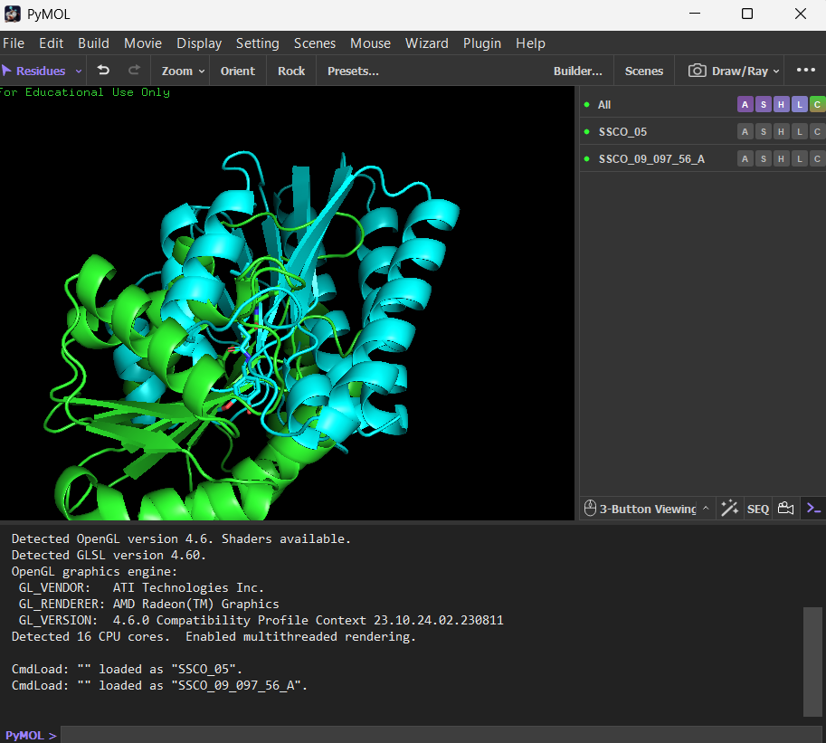
PyMOL
If you open multiple .pdb’s they will appear as object here
SEQ will open the protein sequence

Slide 34
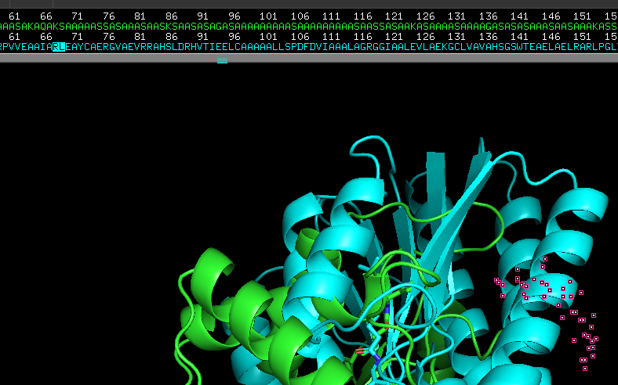
PyMOL
Highlighted residues will appear with dots on each of the atoms

Slide 35
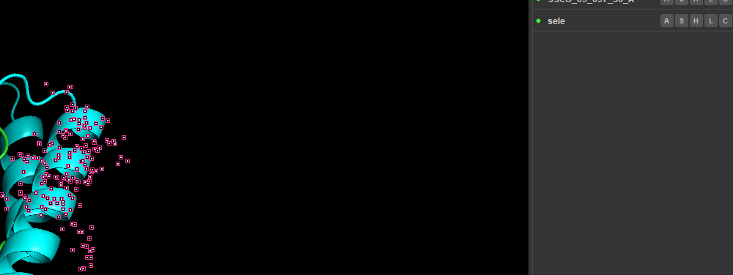
PyMOL
Highlighted residues can be modified in the sele object
“C” will let you change the color of selected objects

Slide 36
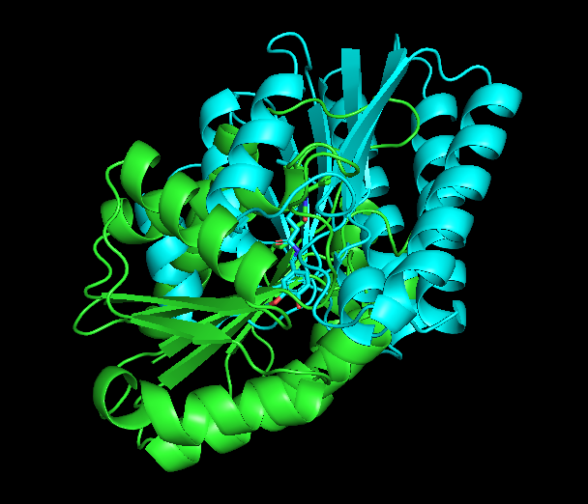
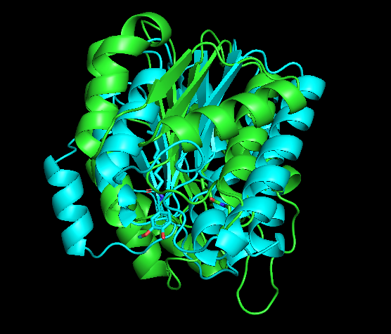
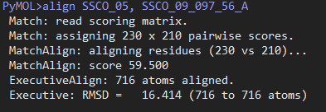
PyMOL
Command to align structures: align obj1, obj2
If you have the console, it will give you information on the quality of the alignment
RMSD is commonly used as an indicator of quality of alignment
RMSD: Root Mean Squared Distance

